Slide 1
White Wine Quality
April Meyer
DSC530 Data Exploration and Analysis

Slide 2
Overview of Dataset
Two datasets
Red Wine
4898 Instances
1599 Instances
White Wine
4898 Instances
6497 Instances Combined
13 Attributes (columns)
Listed to the right
Type Attribute
created to identify red vs white.
List of Variables
Fixed Acidity
Volatile acidity
Citric acid
Residual sugar
Chlorides
Free sulfur dioxide
Total sulfur dioxide
Density
PH
Sulphates
Alcohol
Quality

Slide 3
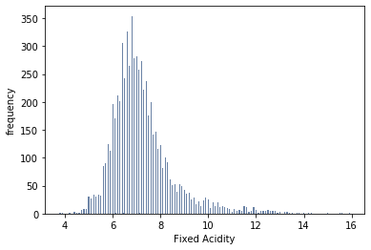
Fixed Acidity
Histogram
Description
Fixed Acidity - most acids involved with wine or fixed or nonvolatile (do not evaporate readily)

Slide 4
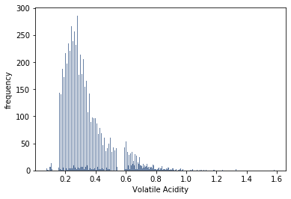
Volatile Acidity
Histogram
Description
The amount of acetic acid in wine, which at too high of levels can lead to an unpleasant, vinegar taste

Slide 5
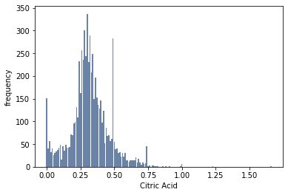
Citric Acid
Histogram
Description
found in small quantities, citric acid can add 'freshness' and flavor to wines

Slide 6
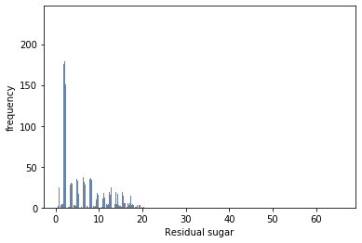
Residual Sugar
Histogram
Description
The amount of sugar remaining after fermentation stops, it's rare to find wines with less than 1 gram/liter and wines with greater than 45 grams/liter are considered sweet

Slide 7
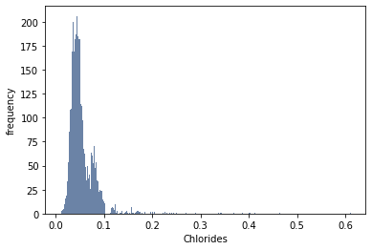
Chlorides
Histogram
Description
The amount of salt in the wine

Slide 8
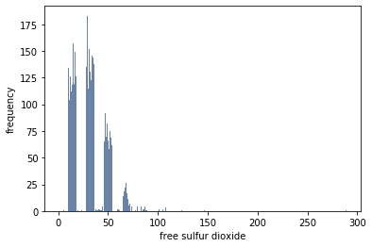
Free Sulfur Dioxide
Histogram
Description
The free form of SO2 exists in equilibrium between molecular SO2 (as a dissolved gas) and bisulfite ion
It prevents microbial growth and the oxidation of wine

Slide 9
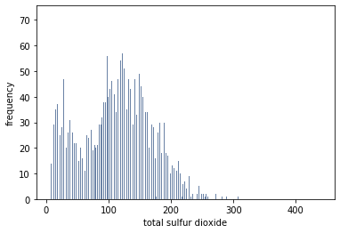
Total Sulfur Dioxide
Histogram
Description
The amount of free and bound forms of S02
In low concentrations, SO2 is mostly undetectable in wine, but at free SO2 concentrations over 50 ppm, SO2 becomes evident in the nose and taste of wine

Slide 10
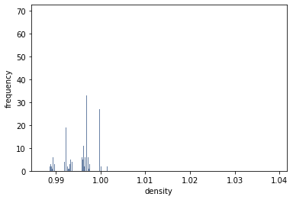
Density
Histogram
Description
The density is close to that of water depending on the percent alcohol and sugar content

Slide 11
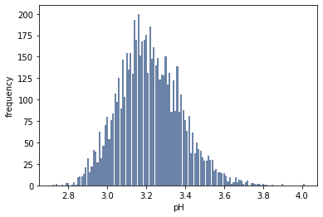
pH
Histogram
Description
Is how acidic or basic a wine is on a scale from 0 (very acidic) to 14 (very basic)
Most wines are between 3-4 on the pH scale

Slide 12
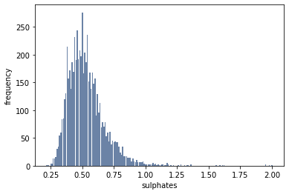
Sulphates
Histogram
Description
A wine additive which can contribute to sulfur dioxide gas (S02) levels
It acts as an antimicrobial and antioxidant

Slide 13
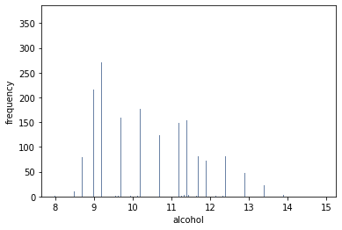
Alcohol
Histogram
Description
A wine additive which can contribute to sulfur dioxide gas (S02) levels
It acts as an antimicrobial and antioxidant

Slide 14
Descriptive Characteristic
 | fixed acidity | volatile acidity | citric acid | residual sugar | chlorides | free sulfur dioxide | total sulfur dioxide | density | pH | sulphates | alcohol | quality
count | 6497.000000 | 6497.000000 | 6497.000000 | 6497.000000 | 6497.000000 | 6497.000000 | 6497.000000 | 6497.000000 | 6497.000000 | 6497.000000 | 6497.000000 | 6497.000000
mean | 7.215307 | 0.339666 | 0.318633 | 5.443235 | 0.056034 | 30.525319 | 115.744574 | 0.994697 | 3.218501 | 0.531268 | 10.491801 | 5.818378
std | 1.296434 | 0.164636 | 0.145318 | 4.757804 | 0.035034 | 17.749400 | 56.521855 | 0.002999 | 0.160787 | 0.148806 | 1.192712 | 0.873255
min | 3.800000 | 0.080000 | 0.000000 | 0.600000 | 0.009000 | 1.000000 | 6.000000 | 0.987110 | 2.720000 | 0.220000 | 8.000000 | 3.000000
25% | 6.400000 | 0.230000 | 0.250000 | 1.800000 | 0.038000 | 17.000000 | 77.000000 | 0.992340 | 3.110000 | 0.430000 | 9.500000 | 5.000000
50% | 7.000000 | 0.290000 | 0.310000 | 3.000000 | 0.047000 | 29.000000 | 118.000000 | 0.994890 | 3.210000 | 0.510000 | 10.300000 | 6.000000
75% | 7.700000 | 0.400000 | 0.390000 | 8.100000 | 0.065000 | 41.000000 | 156.000000 | 0.996990 | 3.320000 | 0.600000 | 11.300000 | 6.000000
max | 15.900000 | 1.580000 | 1.660000 | 65.800000 | 0.611000 | 289.000000 | 440.000000 | 1.038980 | 4.010000 | 2.000000 | 14.900000 | 9.000000

Slide 15
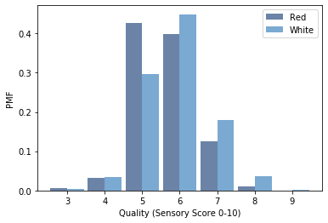
Probability Mass Function PMF
PMF comparing Red Quality to White Quality
Quality is an output variable based on sensory data. The score is between 0 and 10.

Slide 16
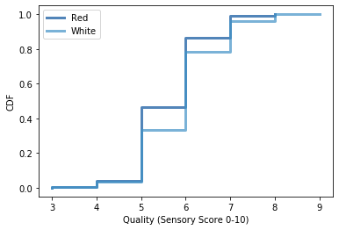
Cumulative Distribution Function
CDF comparing Red Quality to White Quality
Quality is an output variable based on sensory data. The score is between 0 and 10.

Slide 17
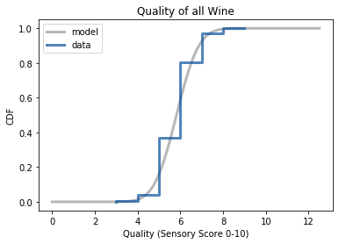
CDF of Normal Distribution
Empirical CDF of Quality for all wines data
The model uses the same mean and variance to create a normal distribution.

Slide 18
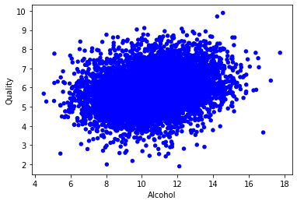
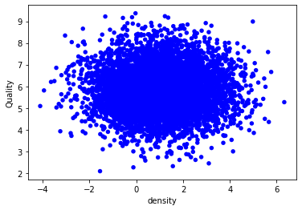
Scatterplots
Alcohol vs Quality
Density vs Quality

Slide 19
Conduct a Test Statistic
Correlation matrix to see what variables correlate the most
 | Fixed acidity | Volatile acidity | Citric acid | Residual sugar | chlorides | Free Sulfur Dioxide | Total Sulfur Dioxide | density | pH | sulphates | alcohol | quality
Fixed acidity | 1.000000 | 0.200272 | 0.270568 | -0.032254 | 0.355964 | -0.259914 | -0.233259 | 0.434056 | -0.250044 | 0.220145 | -0.110650 | -0.098154
Volatile acidity | 0.200272 | 1.000000 | -0.295129 | -0.064384 | 0.415896 | -0.365673 | -0.343534 | 0.261437 | 0.194876 | 0.255042 | -0.023924 | -0.257806
Citric acid | 0.270568 | -0.295129 | 1.000000 | 0.074920 | -0.074084 | 0.122058 | 0.159355 | 0.065690 | -0.285905 | 0.036898 | 0.019653 | 0.105711
Residual sugar | -0.032254 | -0.064384 | 0.074920 | 1.000000 | -0.035800 | 0.387750 | 0.454886 | 0.526664 | -0.229344 | -0.138157 | -0.329218 | -0.016891
chlorides | 0.355964 | 0.415896 | -0.074084 | -0.035800 | 1.000000 | -0.260421 | -0.268434 | 0.590729 | 0.163528 | 0.370450 | -0.401270 | -0.295054
Free Sulfur Dioxide | -0.259914 | -0.365673 | 0.122058 | 0.387750 | -0.260421 | 1.000000 | 0.741438 | 0.005841 | -0.164699 | -0.221062 | -0.186046 | 0.086865
Total Sulfur Dioxide | -0.233259 | -0.343534 | 0.159355 | 0.454886 | -0.268434 | 0.741438 | 1.000000 | 0.061540 | -0.242719 | -0.256745 | -0.308982 | -0.054777
density | 0.434056 | 0.261437 | 0.065690 | 0.526664 | 0.590729 | 0.005841 | 0.061540 | 1.000000 | 0.011777 | 0.274792 | -0.699442 | -0.322806
pH | -0.250044 | 0.194876 | -0.285905 | -0.229344 | 0.163528 | -0.164699 | -0.242719 | 0.011777 | 1.000000 | 0.254263 | 0.140225 | 0.032538
sulphates | 0.220145 | 0.255042 | 0.036898 | -0.138157 | 0.370450 | -0.221062 | -0.256745 | 0.274792 | 0.254263 | 1.000000 | 0.004583 | 0.029831
alcohol | -0.110650 | -0.023924 | 0.019653 | -0.329218 | -0.401270 | -0.186046 | -0.308982 | -0.699442 | 0.140225 | 0.004583 | 1.000000 | 0.446925
quality | -0.098154 | -0.257806 | 0.105711 | -0.016891 | -0.295054 | 0.086865 | -0.054777 | -0.322806 | 0.032538 | 0.029831 | 0.446925 | 1.000000

Slide 20
Conduct a Test Statistic
Drilling down to Quality
fixed_acidity -0.098154
volatile_acidity -0.257806
citric_acid 0.105711
residual_sugar -0.016891
chlorides -0.295054
free_sulfur_dioxide 0.086865
total_sulfur_dioxide -0.054777
density -0.322806
pH 0.032538
sulphates 0.029831
alcohol 0.446925
quality 1.000000

Slide 21
Multiple Regression
Formula = quality ~ volatile_acidity + chlorides + alcohol + density + type
OLS Regression Results ============================================================================== Dep. Variable: quality R-squared: 0.270 Model: OLS Adj. R-squared: 0.269 Method: Least Squares F-statistic: 480.1 Date: Fri, 29 May 2020 Prob (F-statistic): 0.00 Time: 14:51:16 Log-Likelihood: -7315.5 No. Observations: 6497 AIC: 1.464e+04 Df Residuals: 6491 BIC: 1.468e+04 Df Model: 5 Covariance Type: nonrobust ==================================================================================== coef std err t P>|t| [0.025 0.975] ------------------------------------------------------------------------------------ Intercept -26.7271 4.974 -5.373 0.000 -36.479 -16.976 volatile_acidity -1.6653 0.074 -22.371 0.000 -1.811 -1.519 chlorides -0.7941 0.321 -2.472 0.013 -1.424 -0.164 alcohol 0.3632 0.012 31.222 0.000 0.340 0.386 density 29.3009 4.928 5.946 0.000 19.641 38.961 type 0.1603 0.033 4.822 0.000 0.095 0.225 ============================================================================== Omnibus: 115.652 Durbin-Watson: 1.653 Prob(Omnibus): 0.000 Jarque-Bera (JB): 236.026 Skew: 0.015 Prob(JB): 5.59e-52 Kurtosis: 3.933 Cond. No. 8.11e+03 ==============================================================================

Slide 22
Summary
After last semester’s term project, I wanted to pick a cleaner data set to work with. I had used a dataset based on news and combined sources for fatal police shootings in the US. It was missing a lot of variables and was mostly categorical. This time I found a dataset about wines from Portuguese. From what I was reading this is a good beginner data set to work on regression.
There are two different datasets one is red, and one is white. The dataset was downloaded from the UCI Machine Learning Repository. Originally, I was only going to use the white wine dataset but having red to compare seemed to help more. My main question was what physicochemical test) give to higher quality? To answer this, I looked at scatter plots and the correlation matrix using spearman was helpful. I did try to do a multiple regression with all the variables and then scaled back on them. I lost about 0.02 on the R squared.
Overall, I do not think there were many high correlations between quality and the physicochemical variables. The attributes with the highest positive relationship are Alcohol and Citric Acid. Density, Chlorides, and Volatile Acidity with higher negative impact. I was a bit surprised that Total Sulfur Dioxide did not have a bigger negative impact, because supposedly higher amounts are noticeable through smell and taste. I believe information on the grapes used, wine company, and prices would have been helpful. If the dataset were extended to have more wines; I think location would probably be helpful too. In the end I am happier with this project then last semester. I felt like I was understanding what I was doing throughout the different steps. I do think I need to understand the different tests and what they tell you. Also, the many different regression models that are available.
Reference:
P. Cortez, A. Cerdeira, F. Almeida, T. Matos and J. Reis. Modeling wine preferences by data mining from physicochemical properties. In Decision Support Systems, Elsevier, 47(4):547-553, 2009.

